Slide 1


A Comparison of Methods for Approximate Bayesian Computation (ABC)
Zenabu Suboi
Supervised by:
Dr Marijn C. Hazelbag
Prof Wim Delva

Slide 2
Outline
Brief Background and Research Question
Methods to be compared
Obtaining targets
Preliminary Results
Next steps

Slide 3
Background
Calibrating Individual Based Models (IBMs) to empirical data through likelihood estimation is often impossible
ABC allows likelihood-free calibration of models to empirical data
However Rejection ABC is computationally demanding in realistic settings with many parameters
As a result more efficient variants have been proposed

Slide 4
Research Question
Which ABC method performs best when compared under a simple SIR model and a complex IBM simulation setting with respect to:
- computation time
- closeness to the true posterior

Slide 5
Methods to be Compared
Rejection ABC
Requires:
Model under which simulation will be performed
Prior parameter space
Tolerance (ε)
- Proportion to be retained
Distance measure between simulated and observed data
Radius of the acceptance region
Targets (from observed data)
Preferred number of simulations

Slide 6
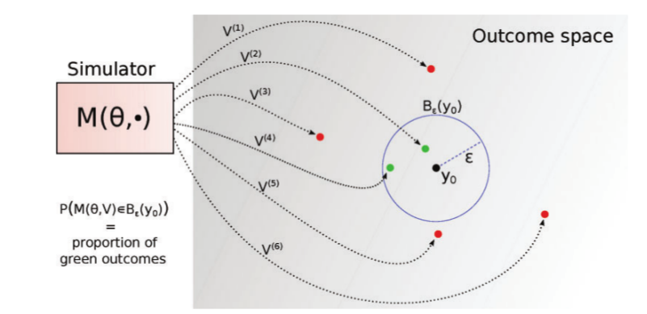
Methods to be Compared Cont.
Rejection ABC
Fig. 1: Rejection ABC [Lintusaari 2017]

Slide 7
Methods to be Compared Cont.
2. Sequential ABC
Requires:
Method (Lenormand)
Model under which simulation will be performed
Prior parameter space
Targets (from observed data)
Preferred number of simulations
Stopping criterion

Slide 8
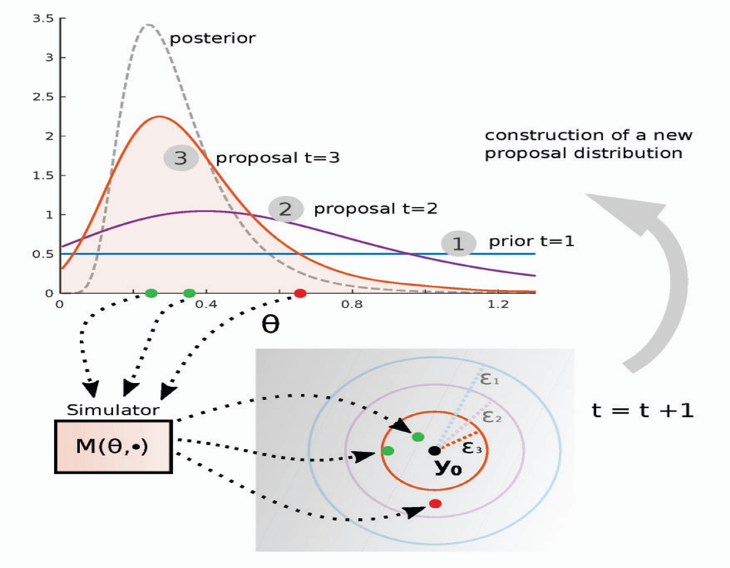
Methods to be Compared Cont.
Sequential ABC
Fig. 2: Sequential ABC [Lintusaari 2017]

Slide 9
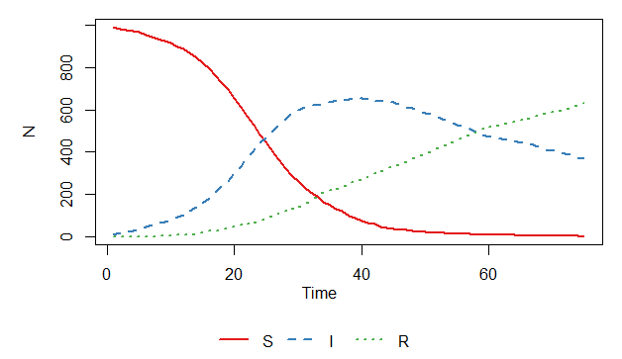
Obtaining targets
Target features: Prevalence at times 50 and 75
“True” parameters: β=0.2 and γ=0.02
Fig. 3: Plot of the stochastic SIR model

Slide 10
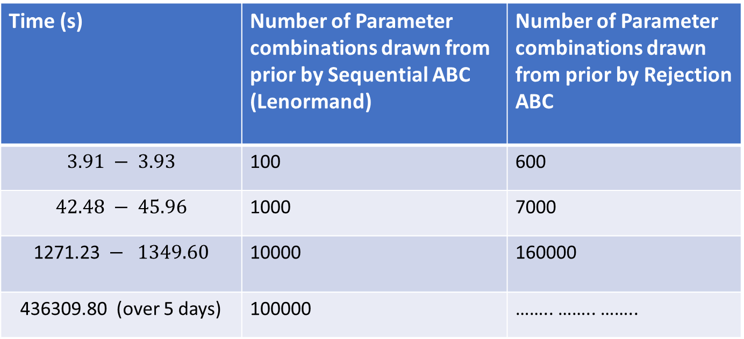
Preliminary Results
Computation times for the two methods under the SIR model
Time (s) | Number of Parameter combinations drawn from prior by Sequential ABC (Lenormand) | Number of Parameter combinations drawn from prior by Rejection ABC
$$3.91 − 3.93$$ | 100 | 600
$$42.48 − 45.96$$ | 1000 | 7000
$$\text{1271.23} − 1349.60$$ | 10000 | 160000
436309.80 (over 5 days) | 100000 | …….. …….. ……..

Slide 11
Next Steps
1. Run simulations
2. Get the gold standard for the SIR model using a raster
3. Compare methods under the SIR model
4. Repeat processes 1 – 3 for the IBM
5. Work
6. And more work …

Slide 12
Acknowledgements
SACEMA
AIMS
Supervisors
SSJC Members
THANK YOU

